Slide 1
Introduction to microbiome data analysis
Anujit Sarkar
Postdoctoral scholar, COPH, CON
USF Genomics Program
Apr 07, 2021

Slide 2
Organization of today's talk
Introduction to microbiome
Components of microbiome
Microbiome at different environments
Importance and applications of microbiome
Ways to study microbiome
16S microbiome study
Metagenomics
Metatranscriptomics
Metaproteomics
Metabolomics
Microbiome multiomics study
Challenges and limitations of microbiome study
Privacy and ethical issues with microbiome studies

Slide 3
Interesting facts about microbes on Earth
The number of microbes in the oceans on earth is astonishing (100 million times more than the number of stars in the known universe)
The total number of bacteria on the earth is estimated to be 10E+30
If all the virus on Earth are laid end-to-end, it will strech beyond 100 million light years (100 times more than the diameter of milky way galaxy)
Interestingly, 20-40% of the bacteria are killed by viruses everyday!!!
One teaspoon of soil contains the number of bacteria equivalent to the human population of Africa

Slide 4
Facts about microbiome
Microbiome is the combined genetic material of all microbes residing on or within a particular niche which can be a living organism
The host and its microbes together is called holobiont
Microbiome is comprised of various components such as bacteria, archea, fungi, protozoa and viruses
Microbiome is much older than humans (3.50 billion years, compared to 250,000 years of human history)
There is a great microbiome beyond human body
The Earth microbiome project studied the diversity across various environments on the planet
Till now, we have sequenced only 10E-20% of the microbial genomes on earth

Slide 5
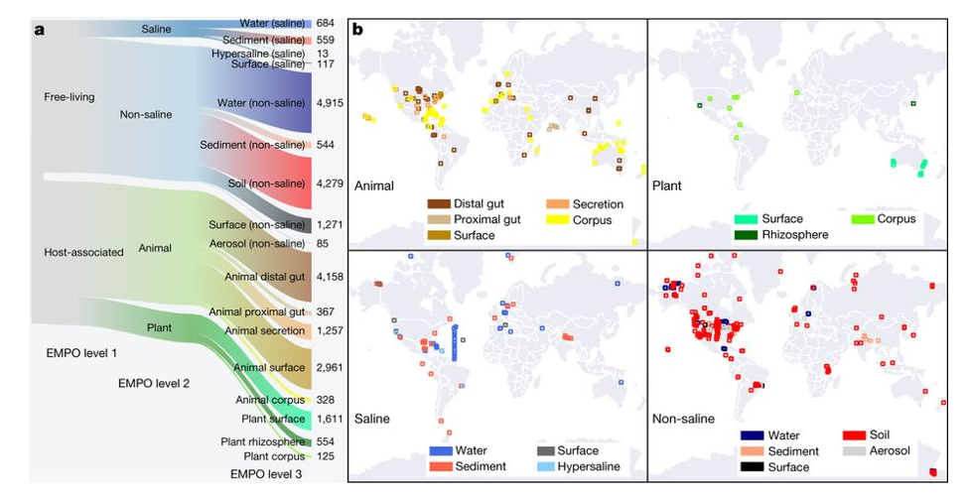
Earth Microbiome project
https://www.nature.com/articles/nature24621

Slide 6
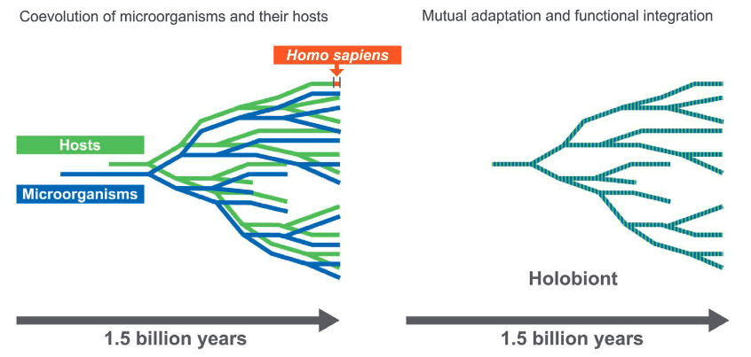
Coevolution of host and microbe
https://www.nature.com/articles/sj.bdj.2016.865

Slide 7
Introduction to human microbiome
https://link.springer.com/chapter/10.1007/978-981-10-7684-8_1
http://www.whatisbiotechnology.org

Slide 8
Facts about human microbiome
The total number of bacteria in human is ~39 trillion
Other microorganisms in the human body are several orders lower than the bacteria
The density of bacteria in dental plaque and colon in human is very high (10E+11 /gm)
The number of genes from the human microbiome exceed that of genome by 150-200-fold
Eight percent of human DNA is derived from the remnants of viral genomes

Slide 9
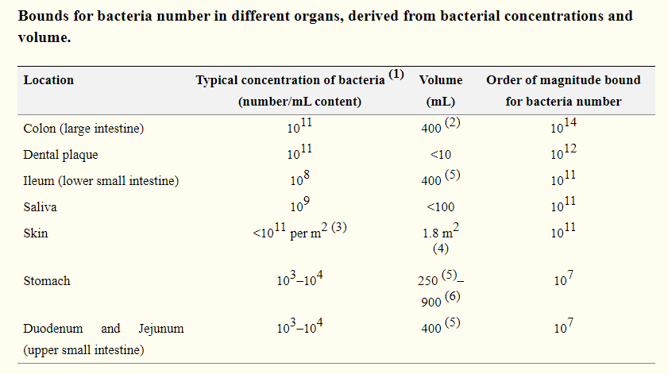
Density of microbes across various sites of human body
https://www.ncbi.nlm.nih.gov/pmc/articles/PMC4991899/

Slide 10
Dynamics of human microbiome
https://www.ncbi.nlm.nih.gov/pmc/articles/PMC5962619/

Slide 11
Function and role of human microbiome
Heterogeneity of the gut microbiome in mice: guidelines for optimizing experimental design (nih.gov)

Slide 12
Major landmarks in human microbiome research
1944: Culturing Anaerobes
1958: FMT for C.difficile infection
1965: Gut microbiota transfer in germ-free mice
1972: Microbiota influences metabolism
of host-directed drugs
1996: Sequence-based identification
of human microbiota
1981: Microbiota succession in early life
https://www.nature.com/immersive/d42859-019-00041-z/index.html

Slide 13
Major landmarks in human microbiome research
2004: Regulation of mucosal immunity
by microbiota
1998: Stability and individuality
of adult microbiota
2003:Beyond bacteria
2005: Importance of adequate feeding
to your microbiota
2006: Importance of diet-microbiota interaction
2006: Transfer of host phenotypes through
microbiota transplantation
https://www.nature.com/immersive/d42859-019-00041-z/index.html

Slide 14
Major landmarks in human microbiome research
2007: Mechanism of colonization
resistance
2007: Functional human microbiota using
omics technologies
2010: Bioinformatic tools enable
large scale microbiome data analysis
2012: Microbiota-gut-brain axis
2012: Modern culturing efforts for microbiota
2018: Microbiota affects response
to cancer therapy
https://www.nature.com/immersive/d42859-019-00041-z/index.html

Slide 15
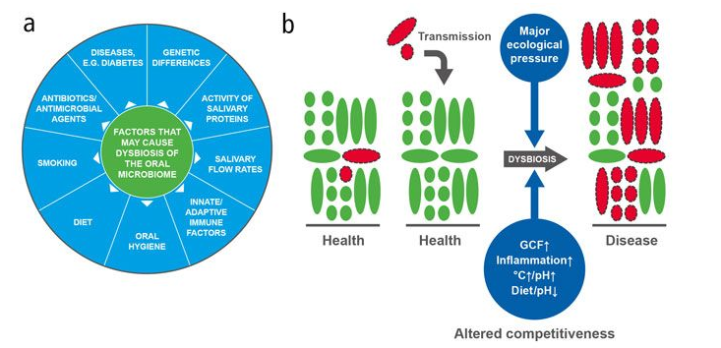
Simplified microbiome dysbiosis model in human diseases
https://www.nature.com/articles/sj.bdj.2016.865

Slide 16
High throughput microbiome approaches
Omics | Microbial material | Outcome | Advantages | Disadvantages
Marker genes (16S, ITS) | 16S rRNA | Microbiota composition | Fast and cheap | Low resolution, PCR bias
Metagenomics | Total DNA | Composition and function potential | High resolution, functional potential characterization | Higher cost, computaionally challenging
Metatranscriptomics | mRNA/cDNA | Gene expression differences | Reveal gene expression | mRNA instability, lack of standard database
Metaproteomics | Proteins | Protein expression profiling | Differences in proteins synthesized by microbiota | Technologically challenging
Metabolomics | Metabolites | Metabolic profiling | Reveal metabolite differences | Lack of reference database, many unknown metabolites

Slide 17
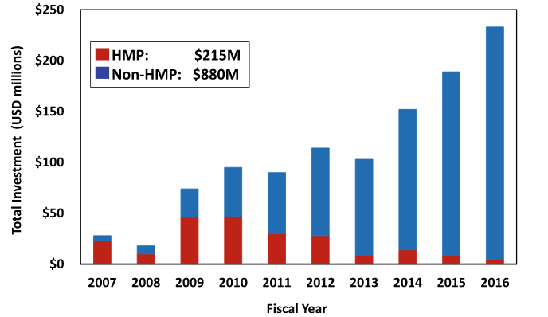
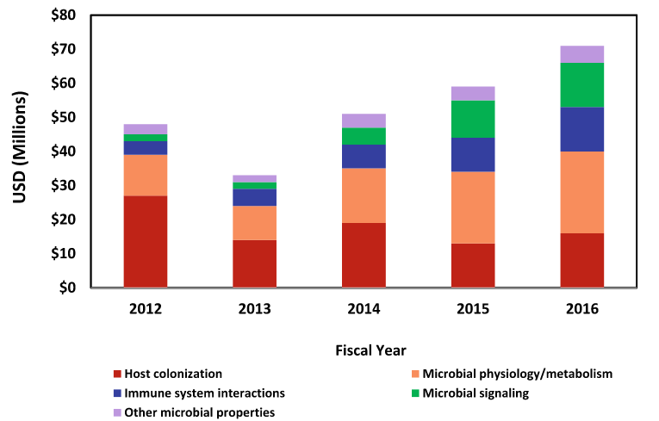
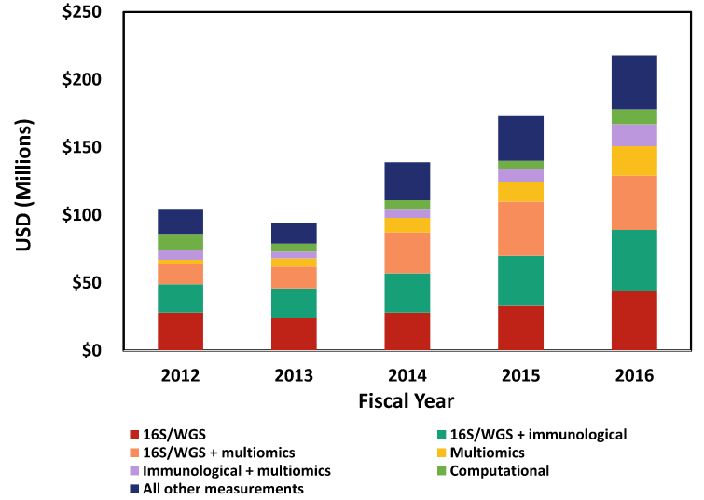
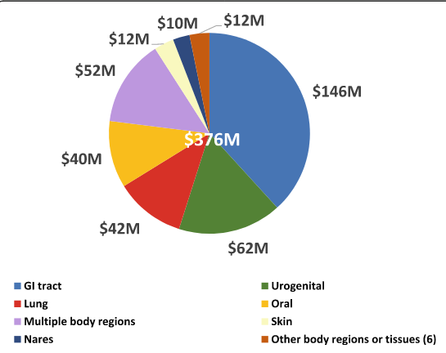
NIH investment in Microbiome
NIH Human Microbiome Portfolio Analysis Team. Microbiome 7 (2019): 1-19.

Slide 18
Major projects on human microbiome
Project | Emphasis
Human Microbiome Project | Computational tools for sequence-based analyses; experimental methodologies; clinical protocols; whole metagenome and 16S metagenome reference databases; ethical, legal, social implications of microbiome research, iHMP
Metagenomics of the Human Intestinal Tract’ (MetaHIT) | Research on GI tract microbiome
Canadian Microbiome Initiative | Various sites of the body
Metagenomics of the Elderly’ (ELDERMET) | Research on elderly GI tract
International Human Microbiome Consortium (IHMC) | Establish standards to the field
MyNewGut’ programme | Diet, brain development and behavior
Metagenopolis’ programme | Therapeutic products for GI diseases

Slide 19
Major projects on human microbiome
Project | Emphasis
American gut project | Understand the gut microbiome and its role
Human Oral Microbiome Database (HOMD) | Identify the composition and store phenotypic, phylogenetic, clinical information
CardioBiome | Bioinformatics platform integrated with the Electronic Health Record for human microbiome analysis
MetaSUB: Metagenomics & Metadesign of Subways & Urban Biomes | Impact of surface type, season, commuter type, or subway design on their commute
The Microbiome Quality Control project (MBQC) | Assessment of techniques, protocols and computational tools
The Michigan Microbiome Project | Manage human microbiome for health benefits

Slide 20

16S rRNA profiling
Different types of bacteria
All protozoa
All fungi
All viruses
20

Slide 21
16S rRNA profiling
Bikel, Shirley, et al." Computational and structural biotechnology journal 13 (2015): 390-401.

Slide 22
Sequence similarity of 16S rRNA gene
Větrovský, Tomáš, and Petr Baldrian. PloS one 8.2 (2013): e57923.

Slide 23
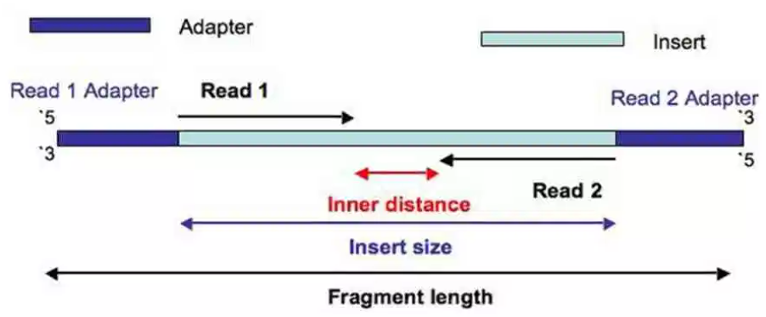
Paired-end sequencing of 16S amplicons
https://thesequencingcenter.com/knowledge-base/what-are-paired-end-reads/

Slide 24
16S microbiome analysis approach
Sequence data
Classify sequences
Taxon abundance Table
Data cleaning (Remove primers, demultiplex, quality filters and chimera removal)
Processed sequences
Metadata (sample information)
Bin related sequences (OTUs)
OTU abundance Table
Representative sequences phylogeny
Samples phylogenetic distance/Unifrac
Figures
Visualization
Alpha Diversity
Amplicon sequence variants/ASVs
ASV Abundance Table
P-values
Hypothesis testing
Beta Diversity

Slide 25
Differences between 16S and Metagenomic approaches
16S | Metagenomics
Targets only one gene | Targets the total DNA from all organisms
Involves PCR amplification step at the beginning | Doesn’t include an initial PCR step
Resolution upto genus level | Resolution upto genus/species/strain level
Less expensive | Expensive
Computationally less challenging | More challenging
Target prokaryotes | Targets all microbes
Resistant to host contamination | Host contamination to be removed
Capable of providing composition | Capable of providing composition as well as functional potential

Slide 26
Summary of metagenomic analysis
Quince, Christopher, et al. Nature biotechnology 35.9 (2017): 833.

Slide 27
Sequence to function (Functional profiling)
http://huttenhower.sph.harvard.edu/humann

Slide 28
Tools and servers for microbiome data analysis
Malla, Muneer Ahmad, et al. Frontiers in immunology 9 (2018).
Mallick, Himel, et al. Genome biology18.1 (2017): 228.

Slide 29
Metatranscriptomics approach for microbiome
Experimental
Bioinformatic
https://www.cd-genomics.com/the-principles-workflow-and-applications-of-metatranscriptomic-sequencing.html

Slide 30
Metaproteomics approach for microbiome
Proteins are the main molecules which are the functional units inside a cell
They are responsible for catalysis of biochemical reactions, molecular transport and cell structure
Investigation of all proteins from one species is called proteomics
Investigation of all proteins from multiple organisms is called metaproteomics

Slide 31
Which questions proteomics can answer
https://msystems.asm.org/content/4/3/e00115-19

Slide 32
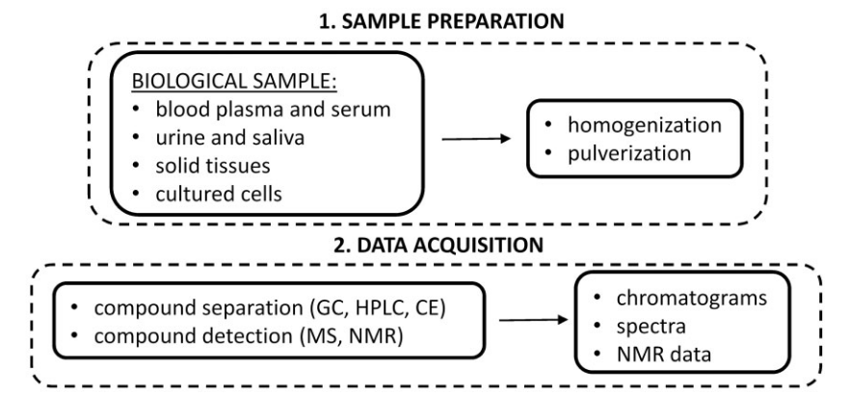
Overview of metabolomics approach (experimental)
https://www.ncbi.nlm.nih.gov/pubmed/27075479

Slide 33
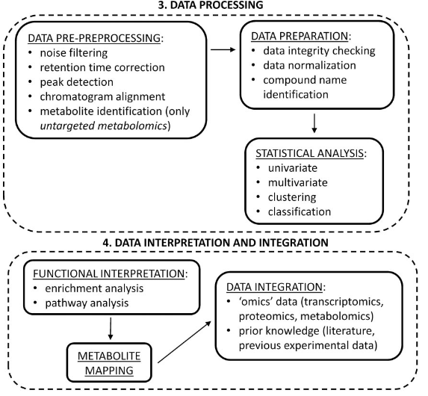
Overview of metabolomics approach (bioinformatic)
https://www.ncbi.nlm.nih.gov/pubmed/27075479

Slide 34
Integrating multi-omics data for microbiome
Franzosa, Eric A., et al. Nature Reviews Microbiology 13.6 (2015): 360.

Slide 35
Major ongoing microbiome projects for human diseases
Valencia, Pedro M., et al. "The human microbiome: opportunity or hype?." (2017): 823.

Slide 36
Challenges for microbiome research
https://www.ncbi.nlm.nih.gov/pubmed/30096310

Slide 37
Challenges for microbiome research
Interaction between various components of microbiome
Interactions between the host and microbiota
Appropriate controls in microbiome research
Setting data and protocol standards at the global level
Difference between human and model organisms

Slide 38
What’s next in human microbiome
Beyond inventories
Holistic view
Data Standard
Coordination and collaboration

Slide 39
Ethical issues of human microbiome study
Human microbiome and personal identity
Psychological and social risks
Protection of privacy
Vulnerability of participants
Biobanks and ownership
Hype in microbiome research and its dangers

Slide 40
Thank the microbiome
Celebrate world microbiome day by (Forbes 2019):
Take a deep breath and thank the microbiome for clean air and oxygen
Treat yourself with fermented foods and drinks
Say no to antibiotics, unless prescribed. Avoid soap with antibiotics

Slide 41


